Slide 1



第8讲
实例：多种设计模式的复合应用
国防科技大学
National University of Defense Technology
董威
wdong@nudt.edu.cn
计算科学系
国防科技大学计算机学院
软件工程方法与实践

Slide 2
1、再次回到鸭子游戏
实现Quackable接口的某些鸭子
重建鸭子模拟器并扩展其能力
public class MallardDuck implements Quackable {
public void quack() {
System.out.println("Quack");
}
}
嘎嘎叫接口Quackable
绿头鸭
public interface Quackable {
public void quack();
}
public class RedheadDuck implements Quackable {
public void quack() {
System.out.println("Quack");
}
}
红头鸭
public class DuckCall implements Quackable {
public void quack() {
System.out.println("Kwak");
}
}
鸭鸣器
public class RubberDuck implements Quackable {
public void quack() {
System.out.println("Squeak");
}
}
橡皮鸭

Slide 3
产生鸭子的模拟器
public class DuckSimulator {
public static void main(String[] args) {
DuckSimulator simulator = new DuckSimulator();
simulator.simulate();
}
void simulate() {
Quackable mallardDuck = new MallardDuck();
Quackable redheadDuck = new RedheadDuck();
Quackable duckCall = new DuckCall();
Quackable rubberDuck = new RubberDuck();
System.out.println("\nDuck Simulator");
simulate(mallardDuck);
simulate(redheadDuck);
simulate(duckCall);
simulate(rubberDuck);
}
void simulate(Quackable duck) {
duck.quack();
}
}
运行结果是什么？

Slide 4
2、如果想在水塘中加入鹅
public class Goose {
public void honk() {
System.out.println("Honk");
}
}
如果想在使用鸭子的地方使用鹅，采用什么模式？
  鸭子和鹅类似，会叫、会飞、会游
适配器模式

Slide 5
如何建立一个鹅适配器？
public class GooseAdapter implements Quackable {
Goose goose;
public GooseAdapter(Goose goose) {
this.goose = goose;
}
public void quack() {
goose.honk();
}
public String toString() {
return "Goose pretending to be a Duck";
}
}

Slide 6
在模拟器中使用鹅
public class DuckSimulator {
public static void main(String[] args) {
DuckSimulator simulator = new DuckSimulator();
simulator.simulate();
}
void simulate() {
Quackable mallardDuck = new MallardDuck();
Quackable redheadDuck = new RedheadDuck();
Quackable duckCall = new DuckCall();
Quackable rubberDuck = new RubberDuck();
Quackable gooseDuck = new GooseAdapter(new Goose());
System.out.println("\nDuck Simulator: With Goose Adapter");
simulate(mallardDuck);
simulate(redheadDuck);
simulate(duckCall);
simulate(rubberDuck);
simulate(gooseDuck);
}
void simulate(Quackable duck) {
duck.quack();
}
}
运行结果是什么？

Slide 7
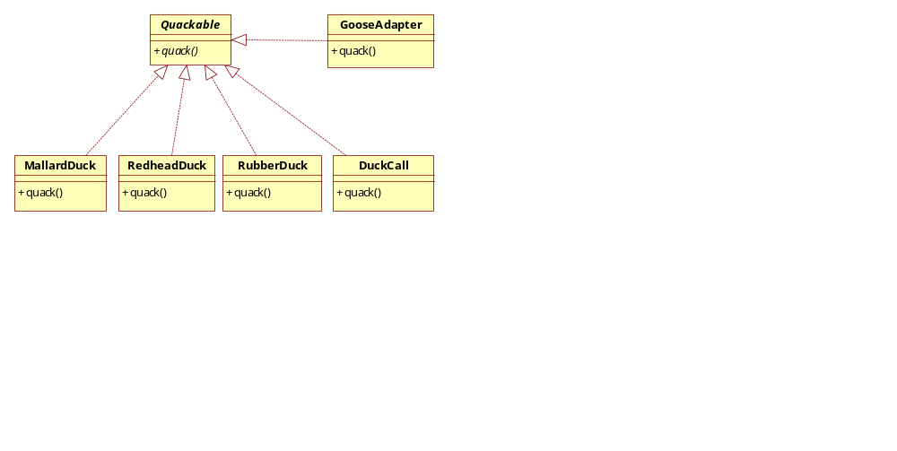
请画出当前的类图

Slide 8
3、有人想统计一个数据
鸭子和鹅混合在一起，那么有多少是鸭子叫的声音
  如何扩展？
public class QuackCounter implements Quackable {
Quackable duck;
static int numberOfQuacks;
public QuackCounter (Quackable duck) {
this.duck = duck;
}
public void quack() {
duck.quack();
numberOfQuacks++;
}
public static int getQuacks() {
return numberOfQuacks;
}
}
装饰者
装饰者模式

Slide 9
创建被装饰鸭子的模拟器
public class DuckSimulator {
public static void main(String[] args) {
DuckSimulator simulator = new DuckSimulator();
simulator.simulate();
}
void simulate() {
Quackable mallardDuck = new QuackCounter(new MallardDuck());
Quackable redheadDuck = new QuackCounter(new RedheadDuck());
Quackable duckCall = new QuackCounter(new DuckCall());
Quackable rubberDuck = new QuackCounter(new RubberDuck());
Quackable gooseDuck = new GooseAdapter(new Goose());
System.out.println("\nDuck Simulator: With Decorator");
simulate(mallardDuck);
simulate(redheadDuck);
simulate(duckCall);
simulate(rubberDuck);
simulate(gooseDuck);
System.out.println("The ducks quacked " +
QuackCounter.getQuacks() + " times");
}
void simulate(Quackable duck) {
duck.quack();
}
}
运行结果是什么？

Slide 10
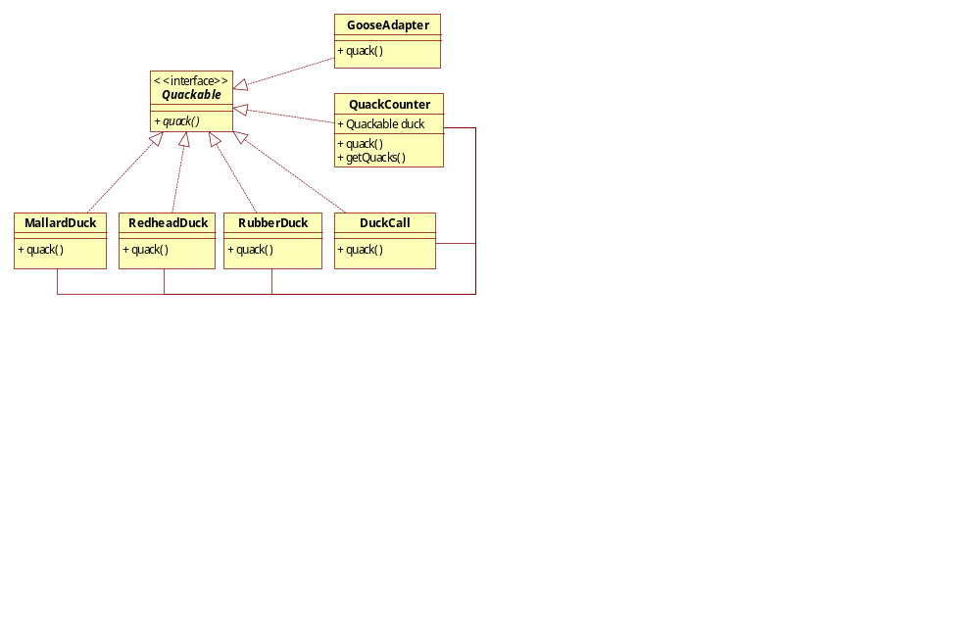
当前的类图？

Slide 11
4、如何成产品系的生成鸭子
把鸭子分成两个系列
  普通的鸭子
  装饰过的可对叫声计数的鸭子
每个系列的使用要一致
可以采用什么设计模式？
抽象工厂模式
如何建立鸭子抽象工厂

Slide 12
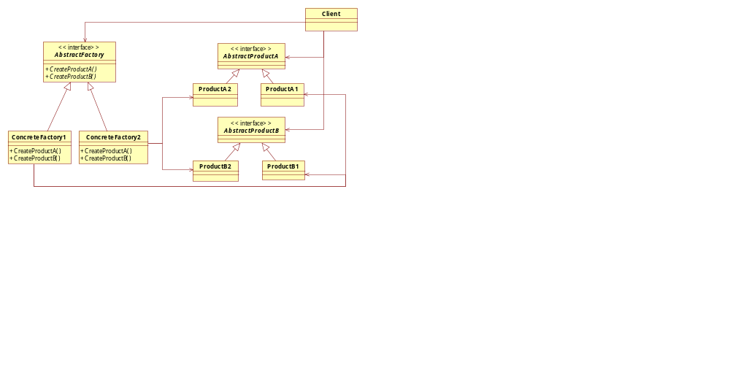
鸭子抽象工厂
public abstract class AbstractDuckFactory {
public abstract Quackable createMallardDuck();
public abstract Quackable createRedheadDuck();
public abstract Quackable createDuckCall();
public abstract Quackable createRubberDuck();
}

Slide 13
创建具体工厂——普通鸭子
public class DuckFactory extends AbstractDuckFactory {
public Quackable createMallardDuck() {
return new MallardDuck();
}
public Quackable createRedheadDuck() {
return new RedheadDuck();
}
public Quackable createDuckCall() {
return new DuckCall();
}
public Quackable createRubberDuck() {
return new RubberDuck();
}
}

Slide 14
创建具体工厂——计数鸭子
public class CountingDuckFactory extends AbstractDuckFactory {
public Quackable createMallardDuck() {
return new QuackCounter(new MallardDuck());
}
public Quackable createRedheadDuck() {
return new QuackCounter(new RedheadDuck());
}
public Quackable createDuckCall() {
return new QuackCounter(new DuckCall());
}
public Quackable createRubberDuck() {
return new QuackCounter(new RubberDuck());
}
}

Slide 15
新的鸭子模拟器
public class DuckSimulator {
public static void main(String[] args) {
DuckSimulator simulator = new DuckSimulator();
AbstractDuckFactory duckFactory = new CountingDuckFactory();
simulator.simulate(duckFactory);
}
void simulate(AbstractDuckFactory duckFactory) {
Quackable mallardDuck = duckFactory.createMallardDuck();
Quackable redheadDuck = duckFactory.createRedheadDuck();
Quackable duckCall = duckFactory.createDuckCall();
Quackable rubberDuck = duckFactory.createRubberDuck();
Quackable gooseDuck = new GooseAdapter(new Goose());
System.out.println("\nDuck Simulator: With Abstract Factory");
simulate(mallardDuck);
simulate(redheadDuck);
simulate(duckCall);
simulate(rubberDuck);
simulate(gooseDuck);
System.out.println("The ducks quacked " +
QuackCounter.getQuacks() + " times");
}
void simulate(Quackable duck) {
duck.quack();
}
}
运行结果是什么？

Slide 16
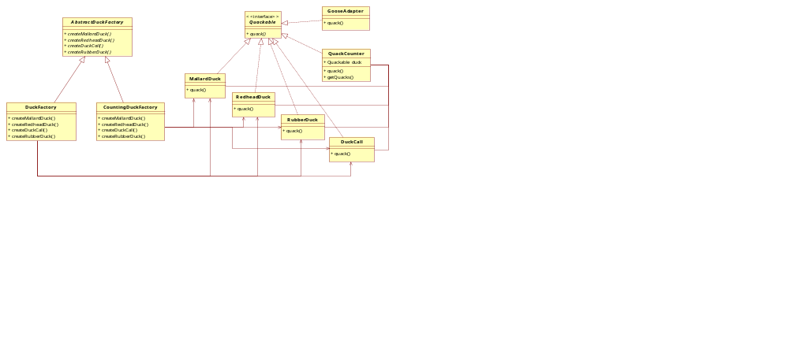
请画出当前的类图

Slide 17
5、如何管理一群鸭子而不是每个鸭子
……
Quackable mallardDuck = duckFactory.createMallardDuck();
Quackable redheadDuck = duckFactory.createRedheadDuck();
Quackable duckCall = duckFactory.createDuckCall();
Quackable rubberDuck = duckFactory.createRubberDuck();
Quackable gooseDuck = new GooseAdapter(new Goose());
simulate(mallardDuck);
simulate(redheadDuck);
simulate(duckCall);
simulate(rubberDuck);
simulate(gooseDuck);
……
如果要成批管理大量对象，会使得代码可维护性很差。
采用什么模式管理一群鸭子？

Slide 18
统一管理一群鸭子
采用统一的接口来添加鸭子，可以一只只加，也可以一次加入一群
采用一个接口来让一群鸭子嘎嘎叫
如何改造代码？
public class Flock implements Quackable {
ArrayList<Quackable> quackers = new ArrayList<Quackable>();
public void add(Quackable quacker) {
quackers.add(quacker);
}
public void quack() {
Iterator<Quackable> iterator = quackers.iterator();
while (iterator.hasNext()) {
Quackable quacker = iterator.next();
quacker.quack();
}
}
}
组合模式

Slide 19
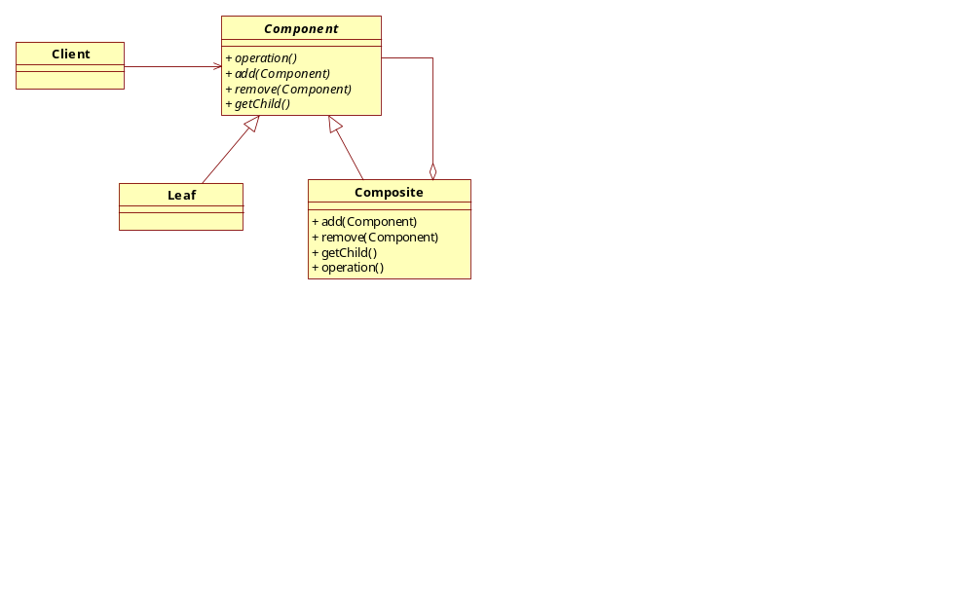
采用组合模式

Slide 20
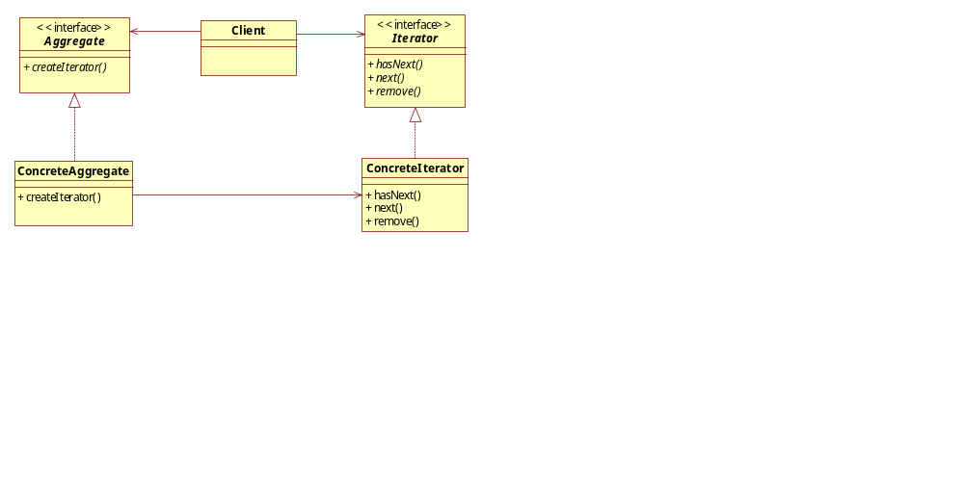
还有其他模式吗？
public class Flock implements Quackable {
ArrayList<Quackable> quackers = new ArrayList<Quackable>();
public void add(Quackable quacker) {
quackers.add(quacker);
}
public void quack() {
Iterator<Quackable> iterator = quackers.iterator();
while (iterator.hasNext()) {
Quackable quacker = iterator.next();
quacker.quack();
}
}
}
队列、列表、集合等
迭代器模式

Slide 21
又一次更新的鸭子模拟器1/3
public class DuckSimulator {
public static void main(String[] args) {
DuckSimulator simulator = new DuckSimulator();
AbstractDuckFactory duckFactory = new CountingDuckFactory();
simulator.simulate(duckFactory);
}
void simulate(AbstractDuckFactory duckFactory) {
Quackable redheadDuck = duckFactory.createRedheadDuck();
Quackable duckCall = duckFactory.createDuckCall();
Quackable rubberDuck = duckFactory.createRubberDuck();
Quackable gooseDuck = new GooseAdapter(new Goose());
System.out.println("\nDuck Simulator: With Composite - Flocks");
……

Slide 22
又一次更新的鸭子模拟器2/3
……
Flock flockOfDucks = new Flock();
flockOfDucks.add(redheadDuck);
flockOfDucks.add(duckCall);
flockOfDucks.add(rubberDuck);
flockOfDucks.add(gooseDuck);
Flock flockOfMallards = new Flock();
Quackable mallardOne = duckFactory.createMallardDuck();
Quackable mallardTwo = duckFactory.createMallardDuck();
Quackable mallardThree = duckFactory.createMallardDuck();
Quackable mallardFour = duckFactory.createMallardDuck();
flockOfMallards.add(mallardOne);
flockOfMallards.add(mallardTwo);
flockOfMallards.add(mallardThree);
flockOfMallards.add(mallardFour);
flockOfDucks.add(flockOfMallards);
……

Slide 23
又一次更新的鸭子模拟器3/3
……
System.out.println("\nDuck Simulator: Whole Flock Simulation");
simulate(flockOfDucks);
System.out.println("\nDuck Simulator: Mallard Flock Simulation");
simulate(flockOfMallards);
System.out.println("\nThe ducks quacked " +
QuackCounter.getQuacks() +
" times");
}
void simulate(Quackable duck) {
duck.quack();
}
}
运行结果是什么？

Slide 24
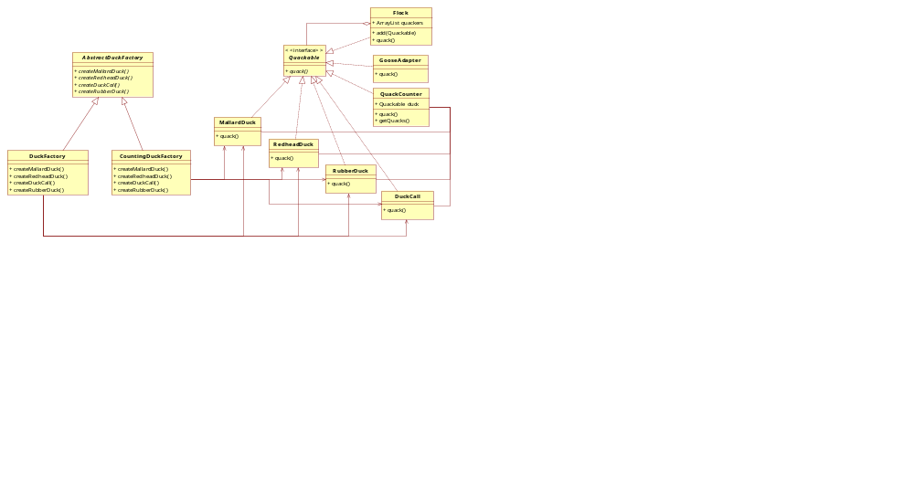
请画出当前的类图

Slide 25
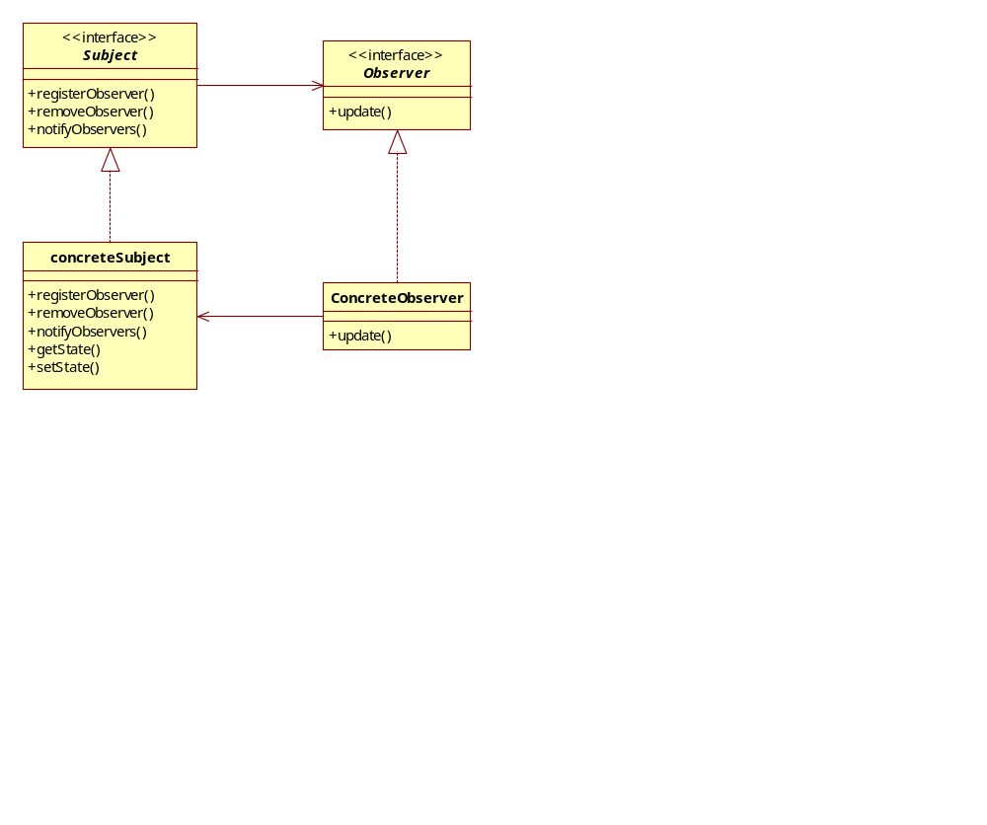
6、想要跟踪某些鸭子的行为
当出现某种行为时（如嘎嘎叫）就通知观察者
采用观察者模式

Slide 26
定义被观察的对象
可被观察的接口
public interface QuackObservable {
public void registerObserver(Observer observer);
public void notifyObservers();
}
可被观察的鸭子接口
public interface Quackable extends QuackObservable {
public void quack();
}

Slide 27
实现注册和通知
public class Observable implements QuackObservable {
ArrayList<Observer> observers = new ArrayList<Observer>();
QuackObservable duck;
public Observable(QuackObservable duck) {
this.duck = duck;
}
public void registerObserver(Observer observer) {
observers.add(observer);
}
public void notifyObservers() {
Iterator<Observer> iterator = observers.iterator();
while (iterator.hasNext()) {
Observer observer = iterator.next();
observer.update(duck);
}
}
}
每只鸭子都需要单独维护一个观察者列表
把观察者列表的创建、观察者的注册和通知委托给另外一个类

Slide 28
整合Observable和Quackable类
public class MallardDuck implements Quackable {
Observable observable;
public MallardDuck() {
observable = new Observable(this);
}
public void quack() {
System.out.println("Quack");
notifyObservers();
}
public void registerObserver(Observer observer) {
observable.registerObserver(observer);
}
public void notifyObservers() {
observable.notifyObservers();
}
}
对于RedheadDuck、GooseAdapter、QuackCounter等都类似

Slide 29
Flock类有区别
public class Flock implements Quackable {
ArrayList<Quackable> ducks = new ArrayList<Quackable>();
public void add(Quackable duck) {
ducks.add(duck);
}
public void quack() {
Iterator<Quackable> iterator = ducks.iterator();
while (iterator.hasNext()) {
Quackable duck = (Quackable)iterator.next();
duck.quack();
}
}
public void registerObserver(Observer observer) {
Iterator<Quackable> iterator = ducks.iterator();
while (iterator.hasNext()) {
Quackable duck = (Quackable)iterator.next();
duck.registerObserver(observer);
}
}
public void notifyObservers() { }
}

Slide 30
构建Observer端
public interface Observer {
public void update(QuackObservable duck);
}
public class Quackologist implements Observer {
public void update(QuackObservable duck) {
System.out.println("Quackologist: " + duck + " just quacked.");
}
}

Slide 31
具有观察能力的鸭子模拟器
public class DuckSimulator {
public static void main(String[] args) {
DuckSimulator simulator = new DuckSimulator();
AbstractDuckFactory duckFactory = new CountingDuckFactory();
simulator.simulate(duckFactory);
}
void simulate(AbstractDuckFactory duckFactory) {
//……创建鸭子和鸭群
System.out.println("\nDuck Simulator: With Observer");
Quackologist quackologist = new Quackologist();
flockOfDucks.registerObserver(quackologist);
simulate(flockOfDucks);
System.out.println("\nThe ducks quacked " +
QuackCounter.getQuacks() + " times");
}
void simulate(Quackable duck) {
duck.quack();
}
}
运行结果是什么？

Slide 32
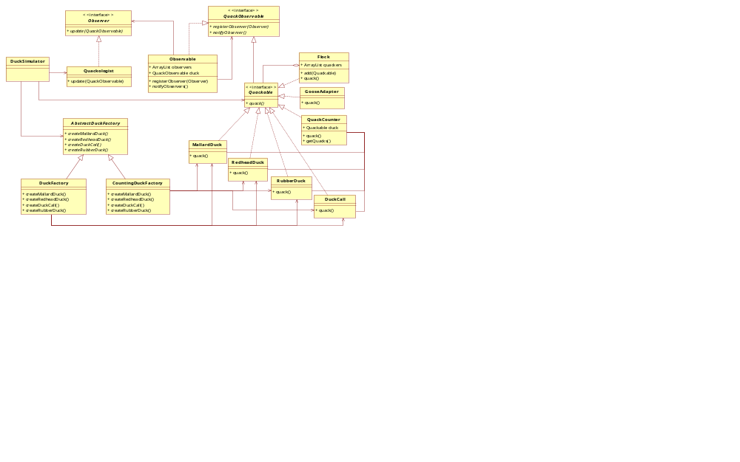
最终的类图

Slide 33
用到了哪些设计模式？
适配器模式
装饰者模式
抽象工厂模式
组合模式
迭代器模式
观察者模式
请在类图中指出每种模式

Slide 34
小结
在软件开发中，通常要使用多种模式。
模式的应用是灵活的，可做适应性变化。
各组在自己的项目中（可以）用到哪些模式？

